Slide 1
Zomato Bangalore Restaurants.
Yeshpal Singh

Slide 2
INDEX :-
Problem Statement
Features
Methodology
Results
Conclusions

Slide 3
Problem Statement
The basic idea of analyzing the Zomato dataset is to get a fair idea about the factors affecting the aggregate rating of each restaurant, establishment of different types of restaurant at different places, Bengaluru being one such city has more than 12,000 restaurants with restaurants serving dishes from allover the world. With each day new restaurants opening the industry has not been saturated yet and the demand is increasing day by day.so Inspite of increasing demand it however has become difficult for new restaurants to compete with established restaurants. As data scientists, we are going to prove that given the right data anything can be predicted.

Slide 4
Features :-
URL :- contains the URL of the restaurant in the Zomato website.
Address :- contains the address of the restaurant in Bengaluru.
Name :- contains the name of the restaurant.
Online order :- whether online ordering is available in the restaurant or not.
Book table :- table book option available or not.
Rate :- contains the overall rating of the restaurant out of 5.
Votes :- contains total number of rating for the restaurant as of the above mentioned date.

Slide 5
Features :-
Phone :- contains the phone number of the restaurant.
Location :- contains the neighborhood in which the restaurant is located.
Rest type :- Type of restaurant.
Average Cost for two :- Cost for two people.
Reviews list :- list of tuples containing reviews for the restaurant, each tuple.
Menu item :- contains list of menus available in the restaurant.
Listed in(type) :- type of meal.
Listed in(city) :- contains the neighborhood in which the restaurant is listed.

Slide 6
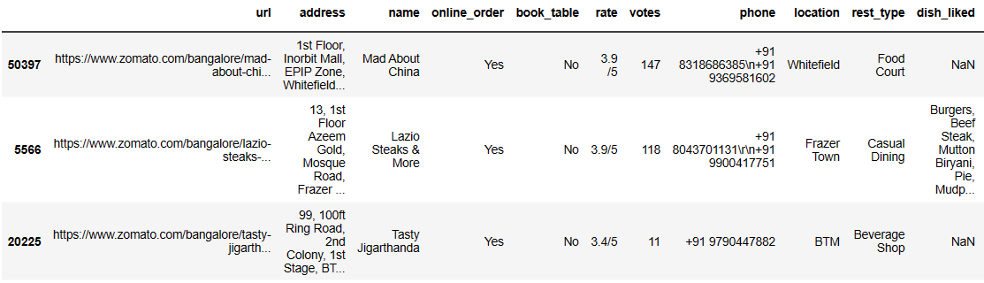
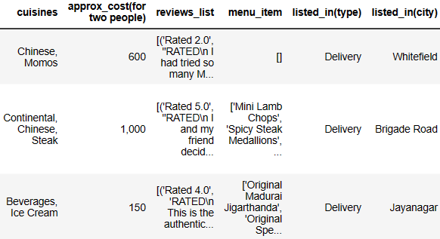
Sample View of the Dataset:-
3/18/2023
ZOMATO BANGALORE RESTAURANTS
6

Slide 7
Methodology
Methodology
Data Collection
EDA
Models
Visualisation

Slide 8
Data Collection
The Zomato Dataset is chosen for my project and is taken from Kaggle, we have used pandas (read csv) function to load the dataset in our notebook. This dataset contain data about the restaurants in Bangalore with their respected rating and some feature columns such as cost, items, online booking etc. which we will be using to build our model.
This dataset contain nearly 51717 rows and with 17 feature columns and this is an regression problem where we will try to predict the rating based on the feature columns.

Slide 9
EDA – Exploratory Data Analysis
First of all, we have checked onto the missing values where we found feature columns like Phone, Rate, Location, Rest type, Dishes liked, Cuisines and approx. cost (for two people) have many missing values so we will treat the missing values either by dropping the missing rows or we can fill it up with their respective mean.
We renamed some columns and in the rate column we changed it to actual rating value (out of 5) , also we dropped city column as it had same values as in location column.
We also extracted all the numerical columns in our dataset to analyse numerical data, so firstly we checked onto the outliers present in the data and we found features like rate, votes, cost2plates ( approx. for 2 people) having some outliers value where we did outlier treatment to votes and cost2plates.
We also checked onto the value counts of features like rest type, cuisines, locations and we basically clustered all those values which had less value for a given range and named that new category as ‘others’.

Slide 10
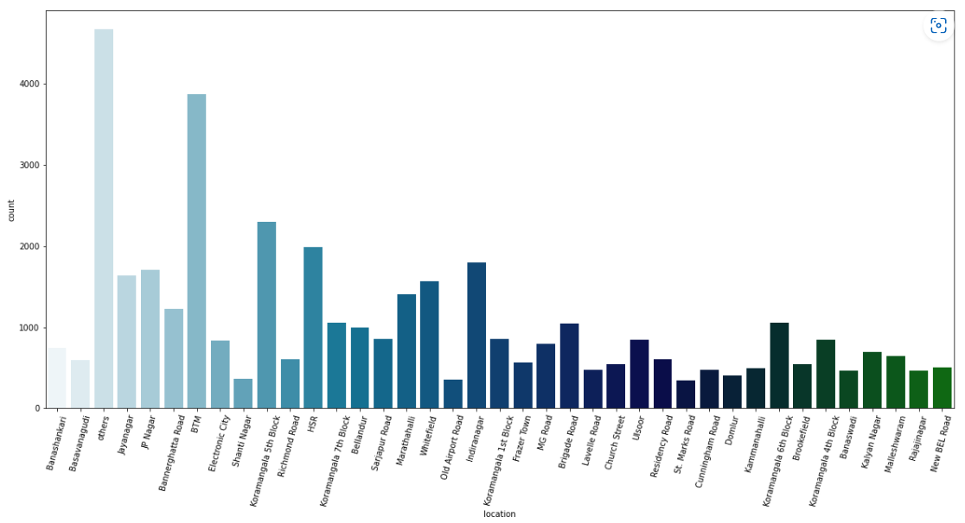
Visualisations :-
Here we can analyse that more no. of restaurants are their in BTM Layout, so by this we can understand that if I want to open a restaurant then I should not open in BTM Layout as there are already many restaurants rather I can choose ‘Old Airport Road’ or ‘St. Marks Road’ as there are less restaurants so there will be high chances of growing business.

Slide 11
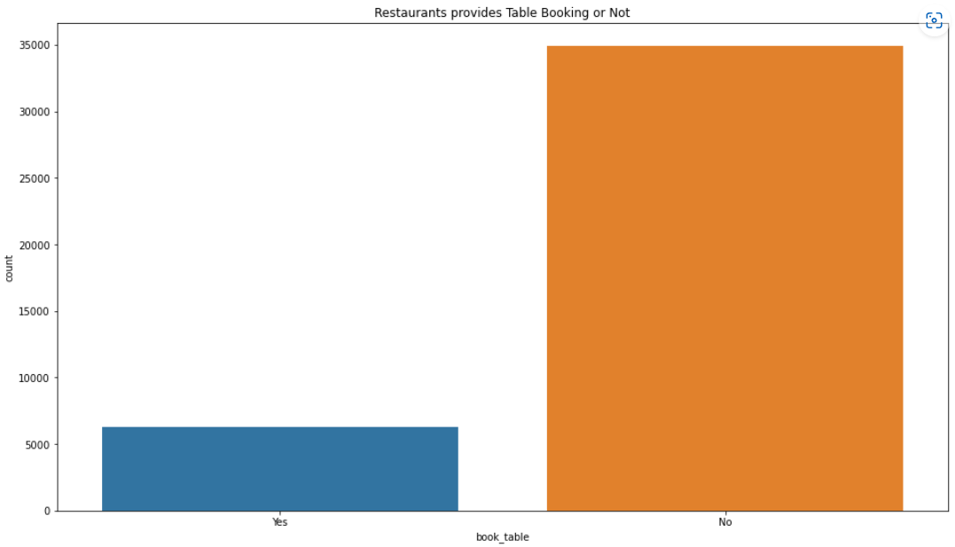
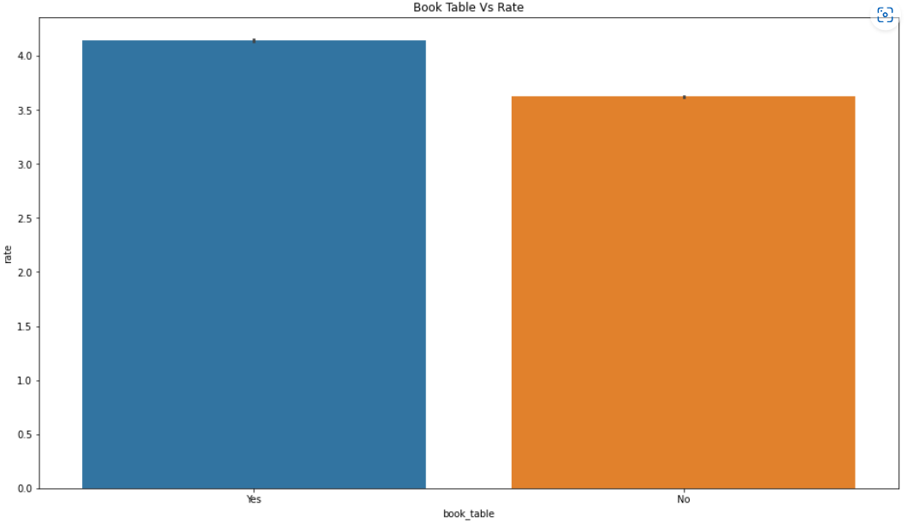
From the below plot we can see a large portion of the Restaurant don't provide Booking Facility.
And also in the second plot, we can see that the restaurant with book table facility have more rating as compared to those who do not have book table facility.

Slide 12
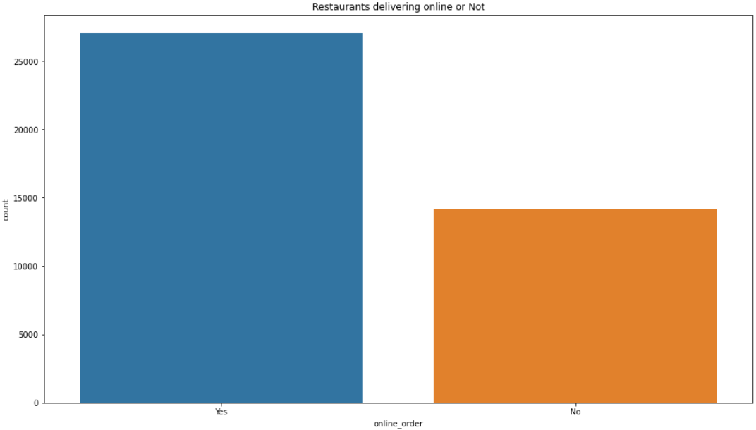
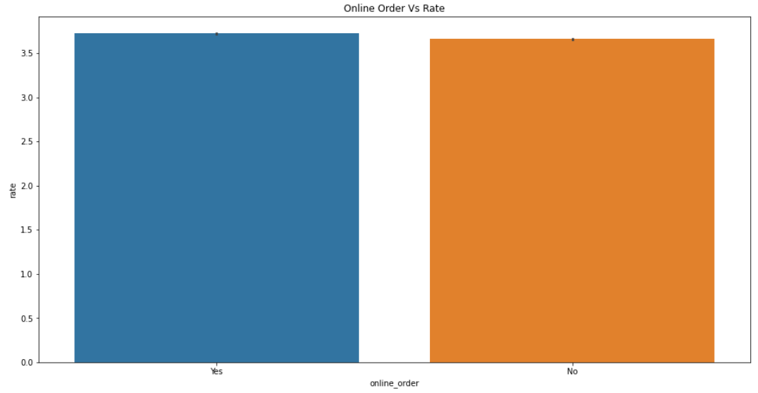
The below Plot indicates that a large segments of the Restaurant have online order facility and many of them do not have online order facility.
so here in the second plot we can see that restaurants with online order have slightly higher rating as compared to no.

Slide 13
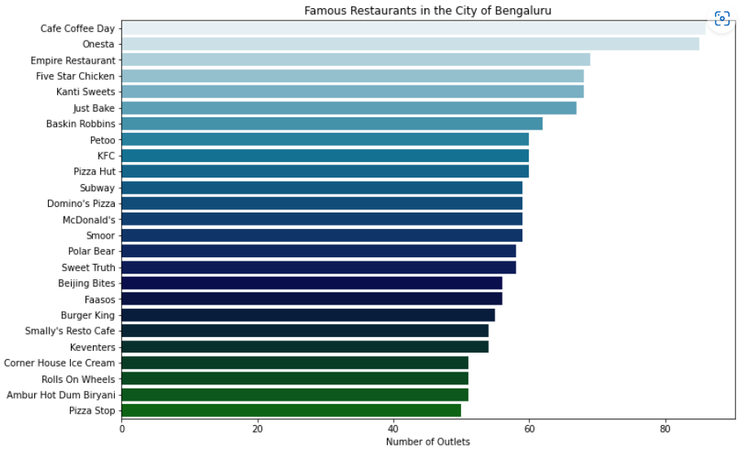
Famous Restaurants in Bangalore :-
Here we can see Restaurants CCD, Onesta, Empire Restaurants have most no. of outlets hence are most famous restaurants at Bangalore.

Slide 14
Assumptions Check :-
We checked on to the correlation for numerical columns and there were no highly correlated columns to be dropped.
We did a linearity check for Linear regression model where we build some plots for dependent and independent variables and we got to know that some of the independent variables form an accurately linear shape like book table, rest type, type do still better than votes and cost2plates which seems to hardly have any specific shape. So it shows that a linear regression fitting might not be the best model for it. A linear model might not be able to efficiently explain the data in terms of variability, prediction accuracy etc.
We checked the rate column distribution and saw it was normally distributed.
We also checked for the normality of residuals and the mean was near to zero.
We also build QQ plot and saw the lines were kind of overlapping which means the data can be approximately modeled by the target distribution.
We checked homoscedasticity by plotting scatter plotting predicted and residual values and hence found the plot was not making any particular shape.

Slide 15
Model Built Along with their Accuracy :-
Linear Regression – 29.08%
Decision Tree – 83.34%
Random Forest – 93.56%
X-GB Regressor – 79.50%
Gradient Boosting Regressor – 53%

Slide 16
RESULT :-
Best Model –
Random Forest Regressor :-
Mean Absolute Error (MAE) :- 0.05
Mean Squared Error (MSE :- 0.012
Root Mean Squared Error (RMSE) :- 0.11
R2 Score :- 0.93569
Root Mean Square Log Error (RMSLE) :- -2.204

Slide 17
Conclusions :-
41,190 data points with 9 feature and 1 output columns have been processed to build the models.
As the number of restaurants are more in BTM layout so we should not open restaurants their where as we can open in areas like Old airport road, Saint marks road etc.
Also we should have online booking facility as there are large proportion of restaurants not having online booking facility and the ratings are higher of the restaurant with online facility as compared to no online booking facility.
And talking about the online order facility we should have online order facility as there many restaurants with online order facility where as the ratings have slightly difference with restaurants having online order facility have slightly more rating then non online order facility restaurants.

Slide 18
Conclusions :-
Most Famous Restaurants in Bangalore are Cafe Coffee Day, Onesta, Empire Restaurants, Five Star Chicken, Kanti sweets etc as per number of outlets.
With 93.56% of Accuracy we conclude Random Forest Regressor as our best model.

Slide 19
Thank you !
- Yeshpal singh
3/18/2023
ZOMATO BANGALORE RESTAURANTS
19

